Slide 1
Multilingual NLP Tasks
http://www.ixa.eus/iltapp/
@ragerri @joseba_fdl @iker_garciaf #iltapp
(some slides adapted from ANLP, David Bamman)

Slide 2


Slide 3
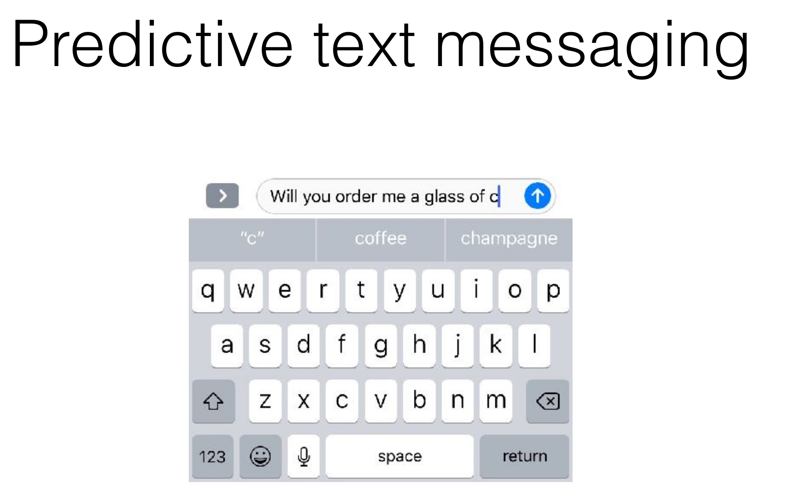

Slide 4
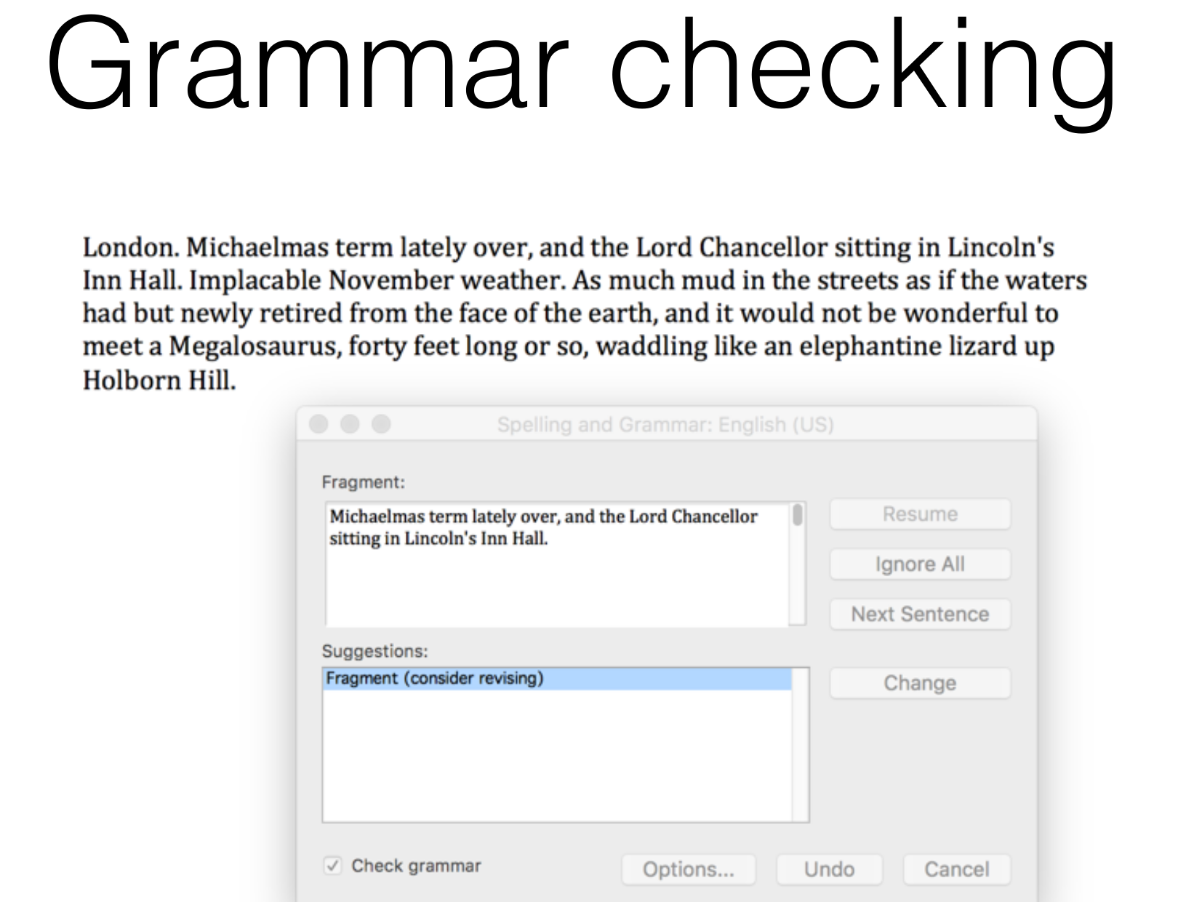

Slide 5
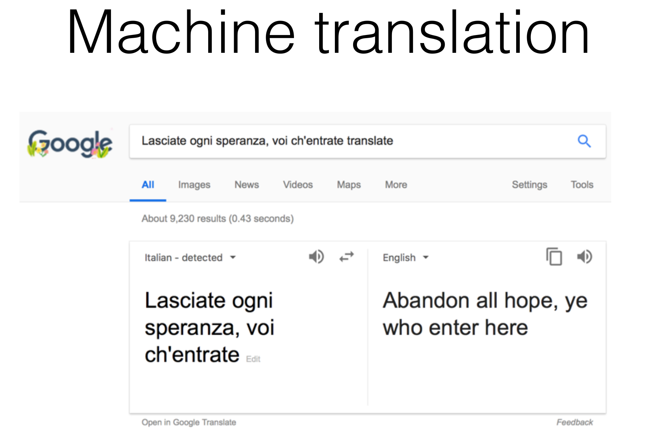

Slide 6
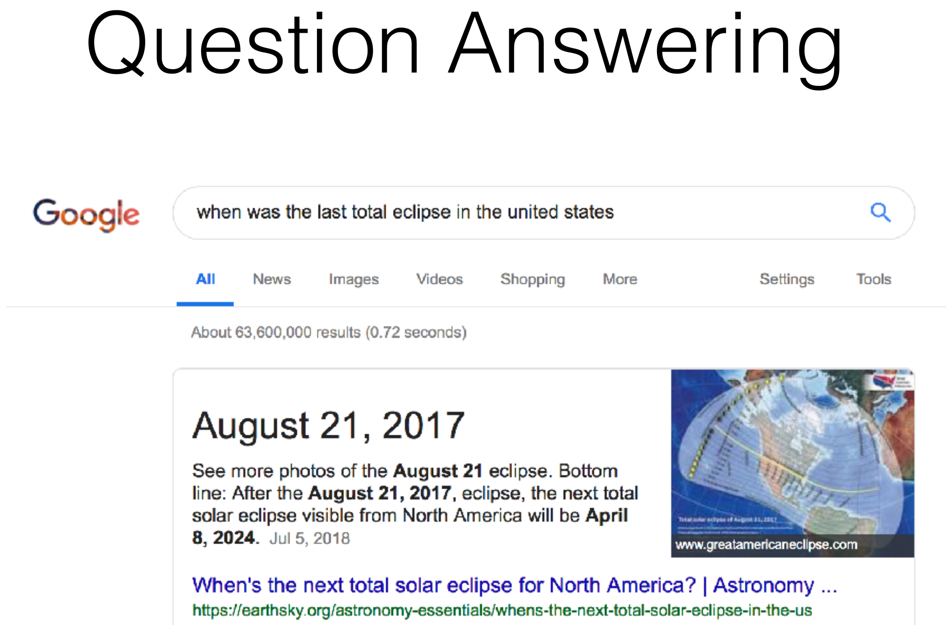

Slide 7
Multidisciplinarity
Machine Learning
Linguistics
Social sciences
Humanities

Slide 8
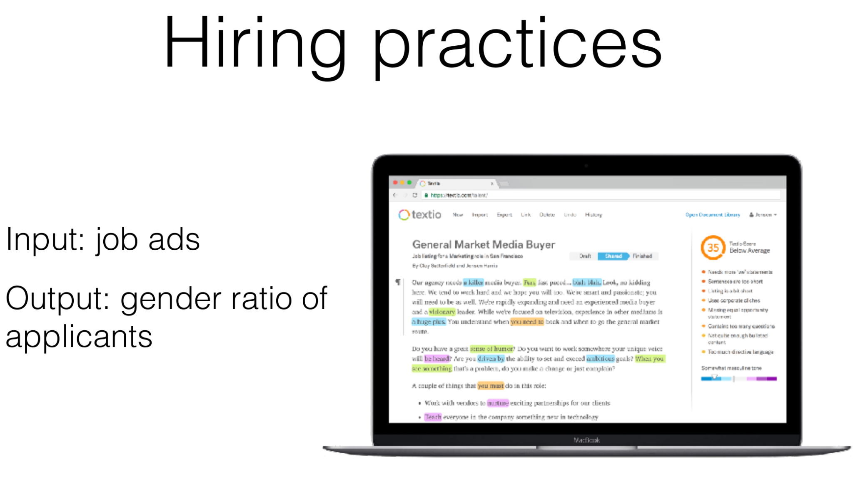

Slide 9
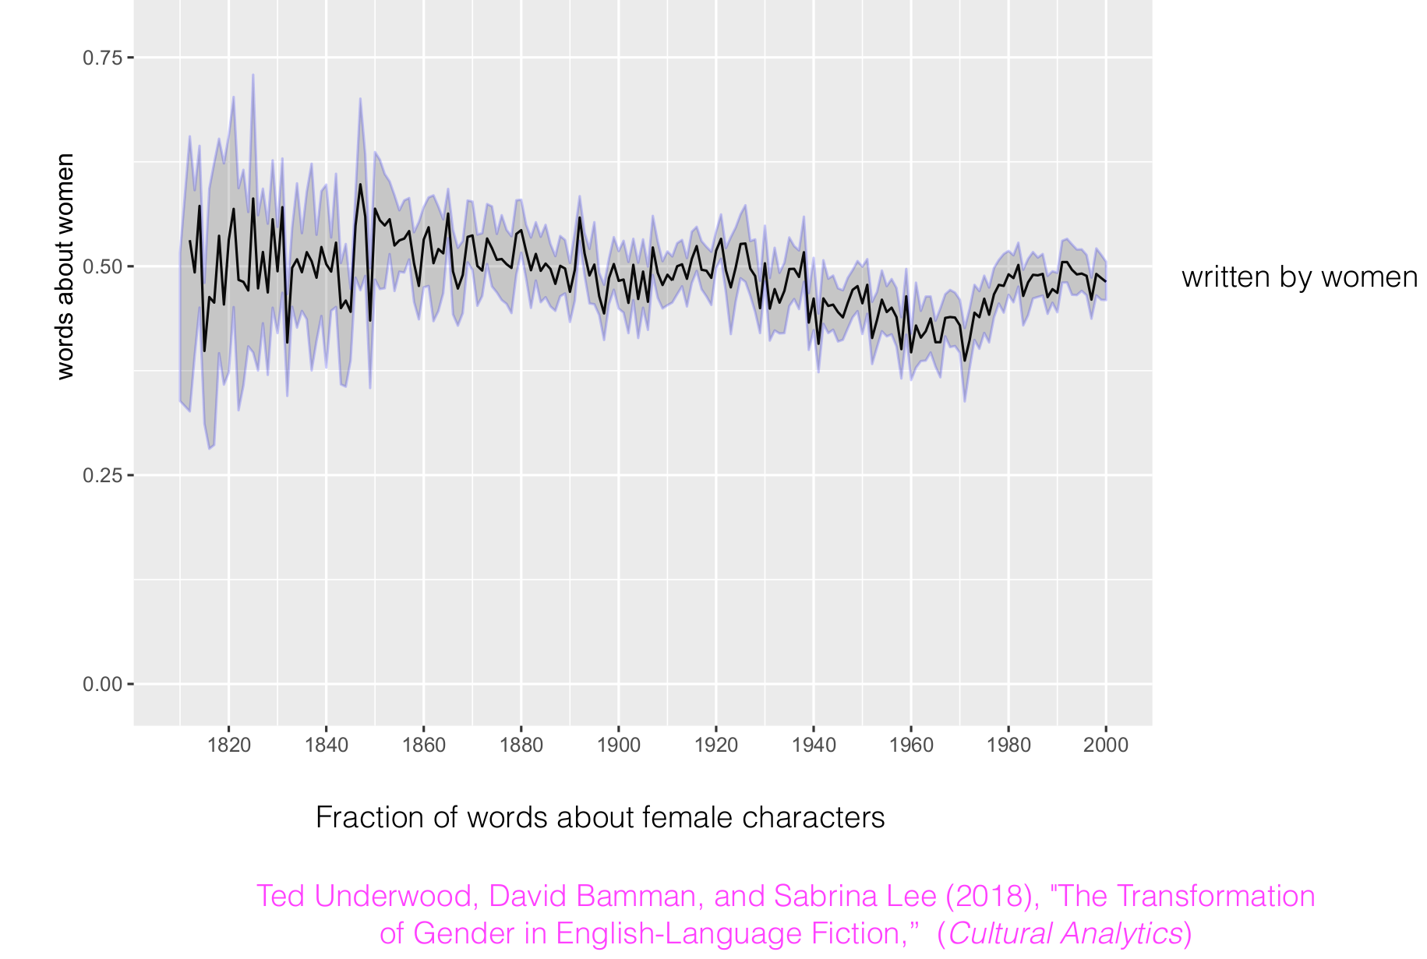

Slide 10
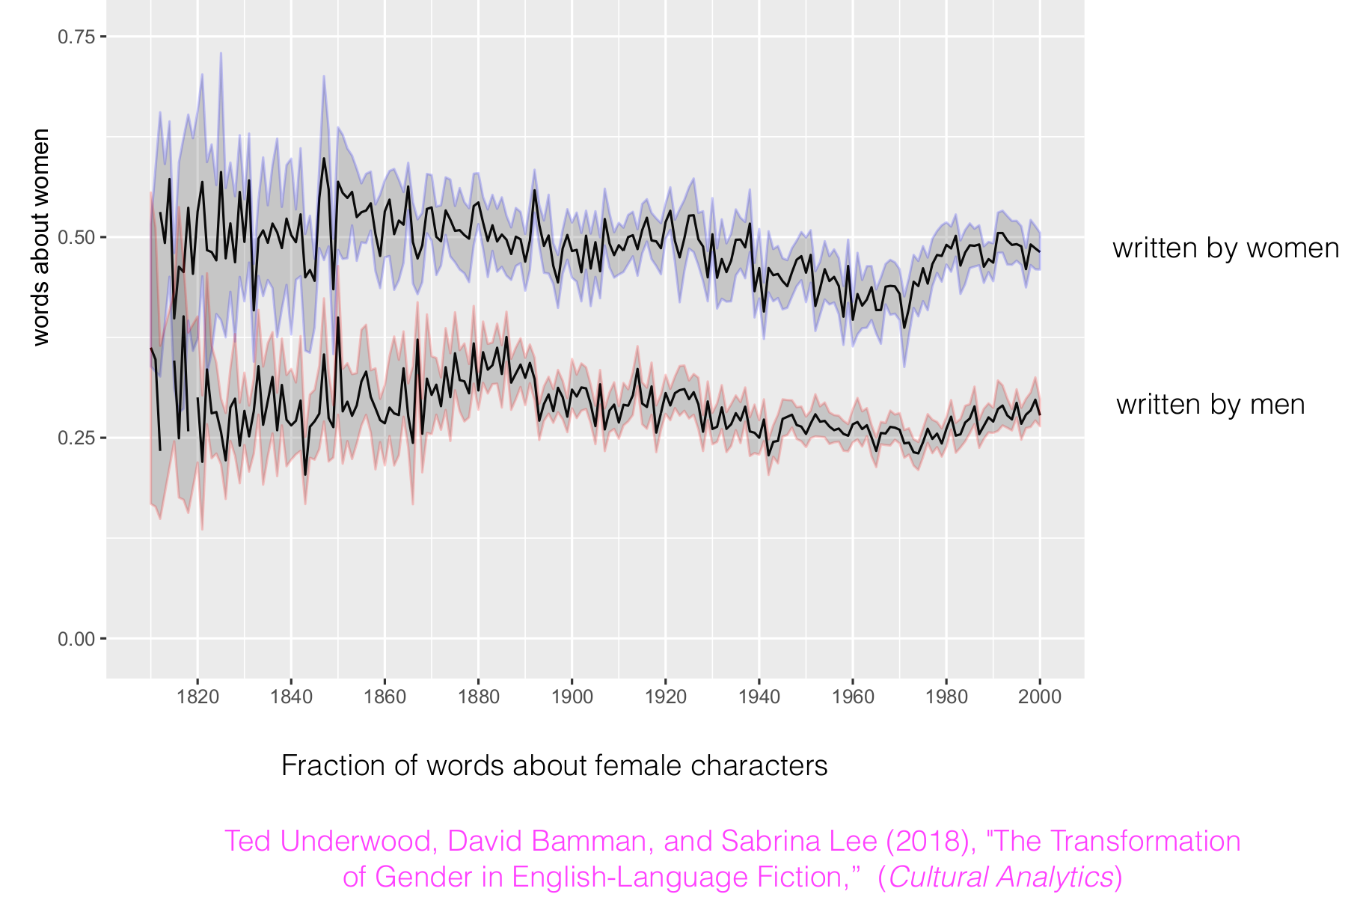

Slide 11
Measurement
This is fundamentally a problem of measurement: how do we design an algorithmic instrument that can transform a text into a quantity?

Slide 12
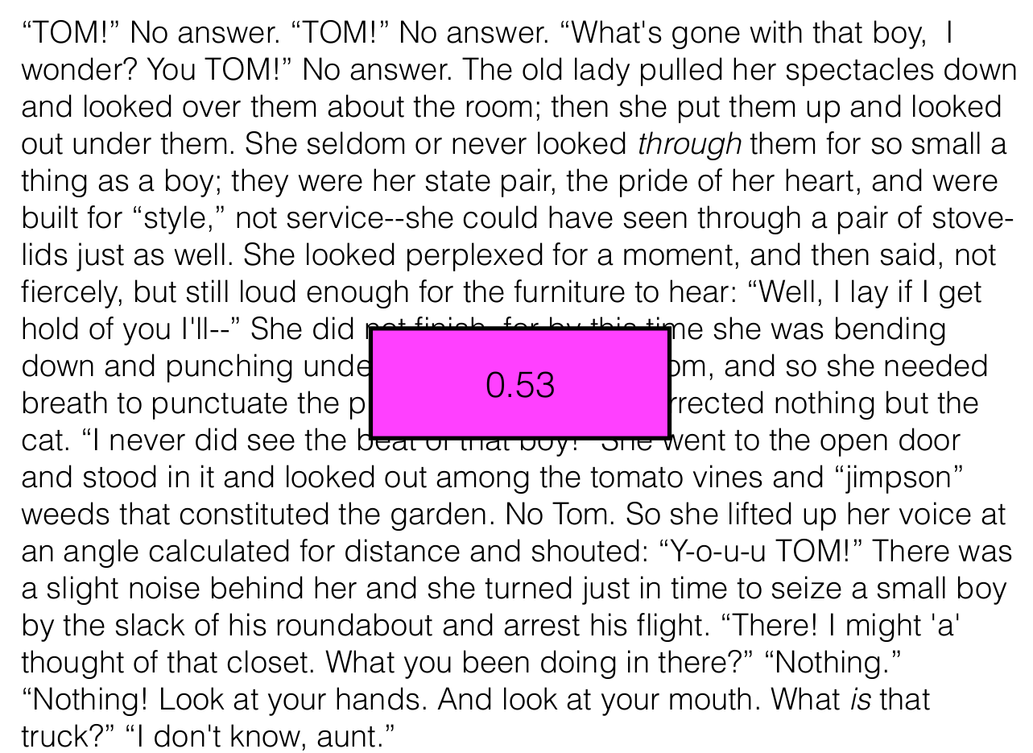

Slide 13
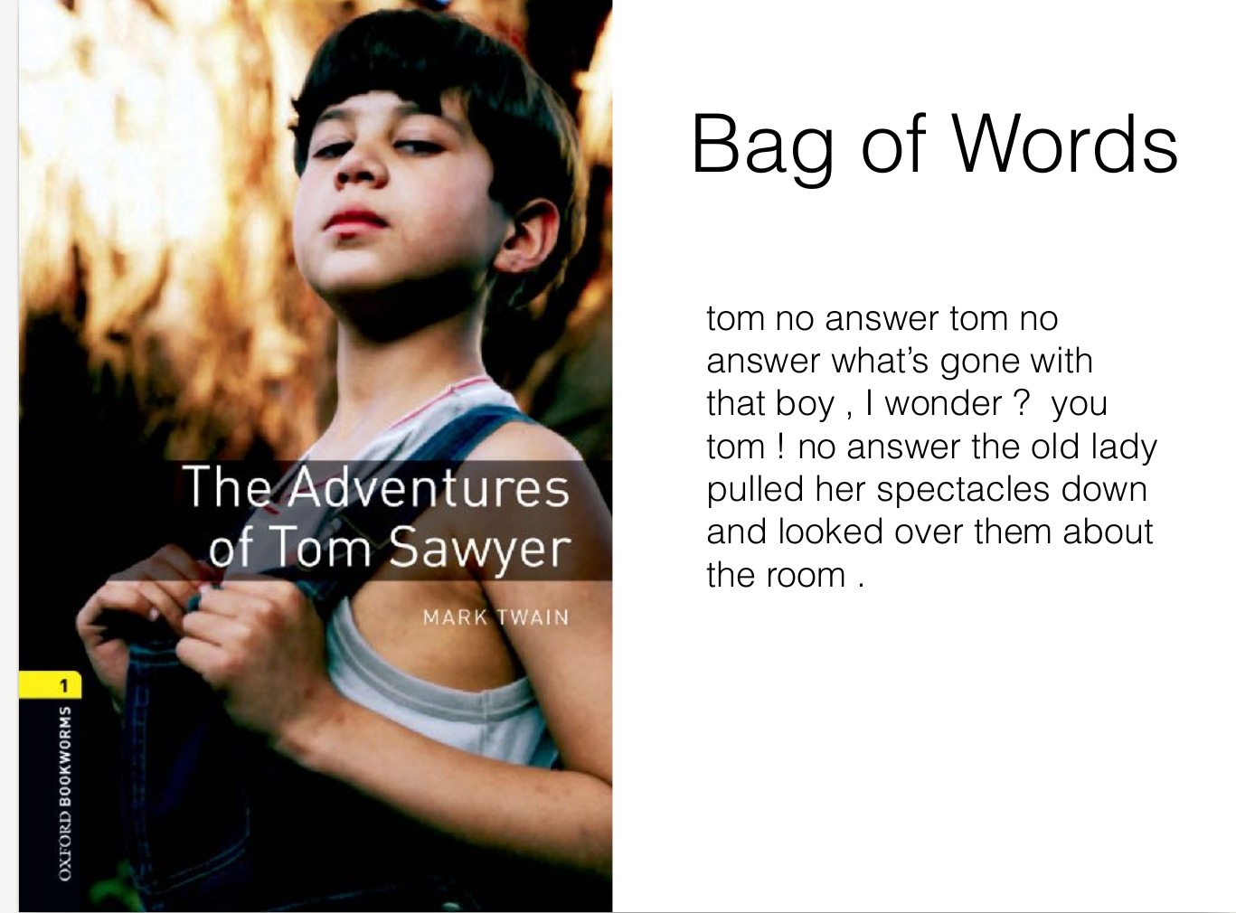

Slide 14
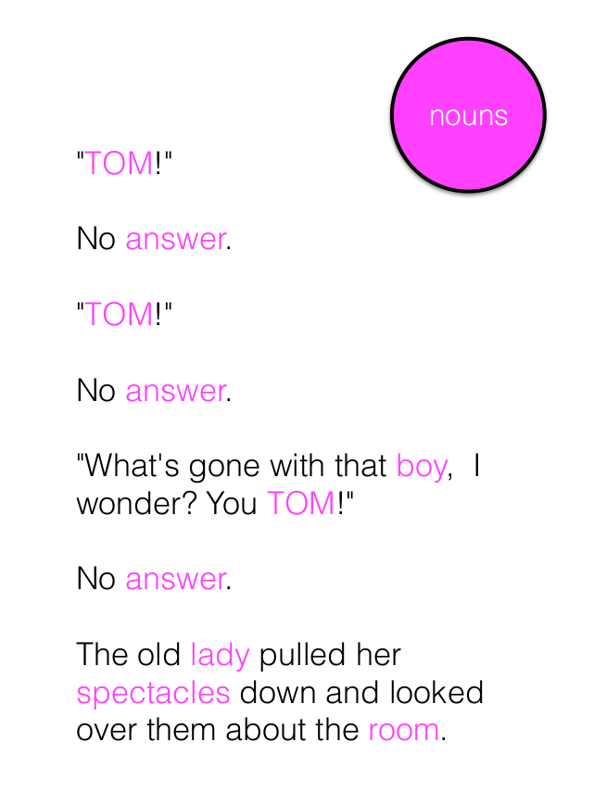
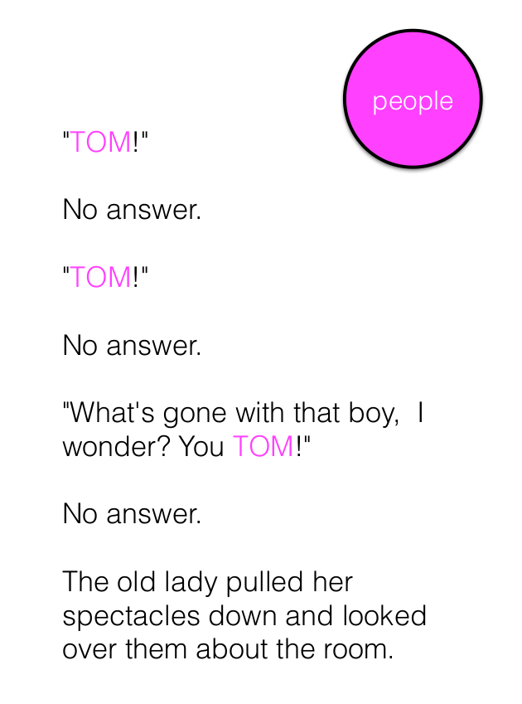

Slide 15
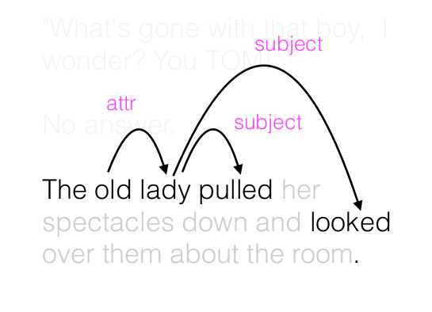
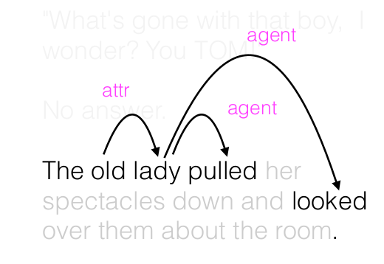

Slide 16
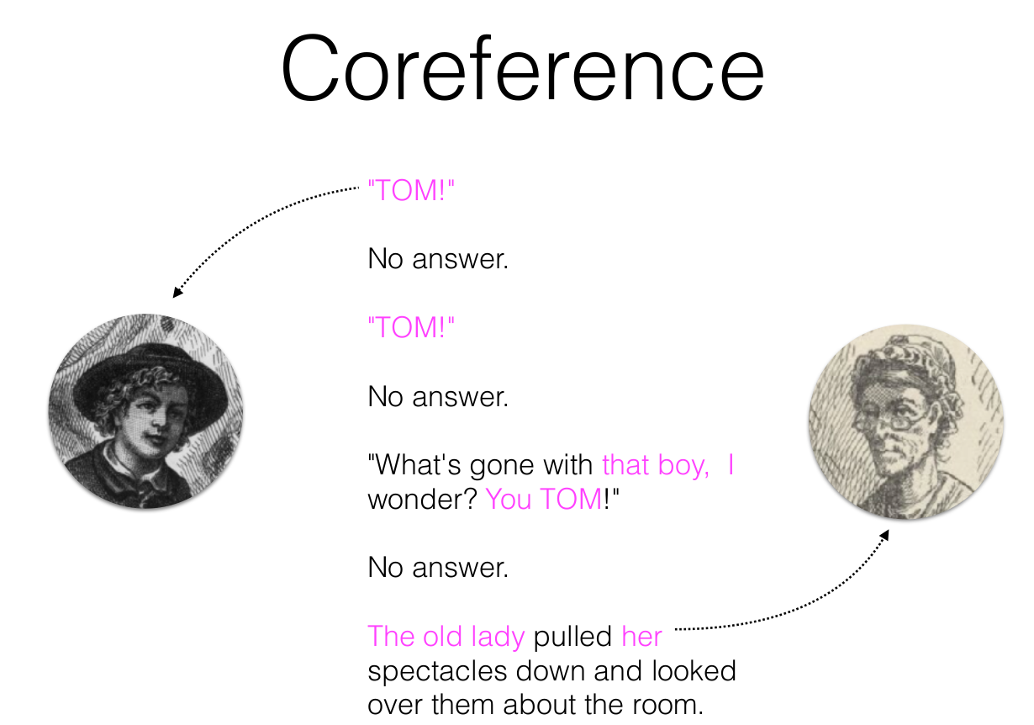

Slide 17
Complexity of language understanding
Language is a complex social process
Ambiguity at every representation level
Speech Acts (“Can you please pass the salt?) Searle 1969
Implicatures (“The opera singer was amazing; she sang all the notes”) Grice 1975
Shared knowledge/temporality (“Clinton is running for election”)
Indexicality (“This homework is very hard”)

Slide 18
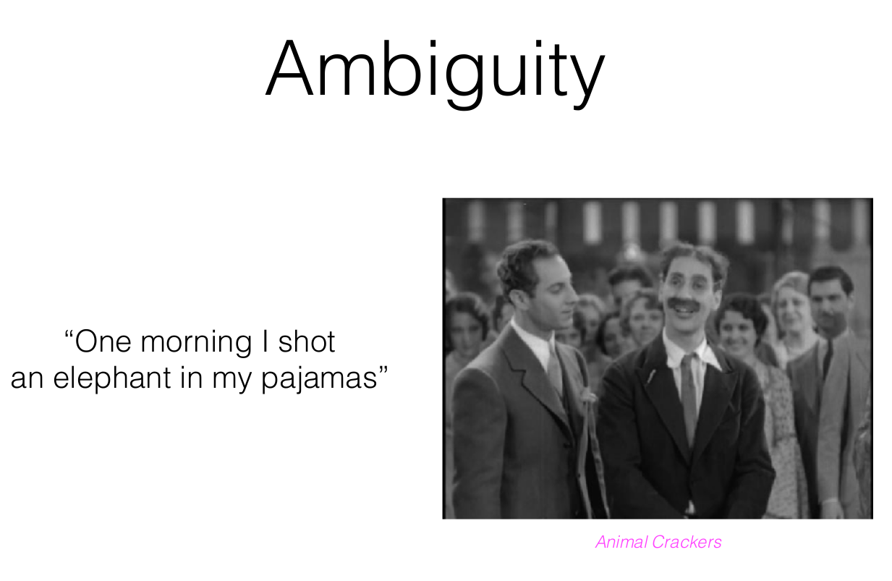

Slide 19
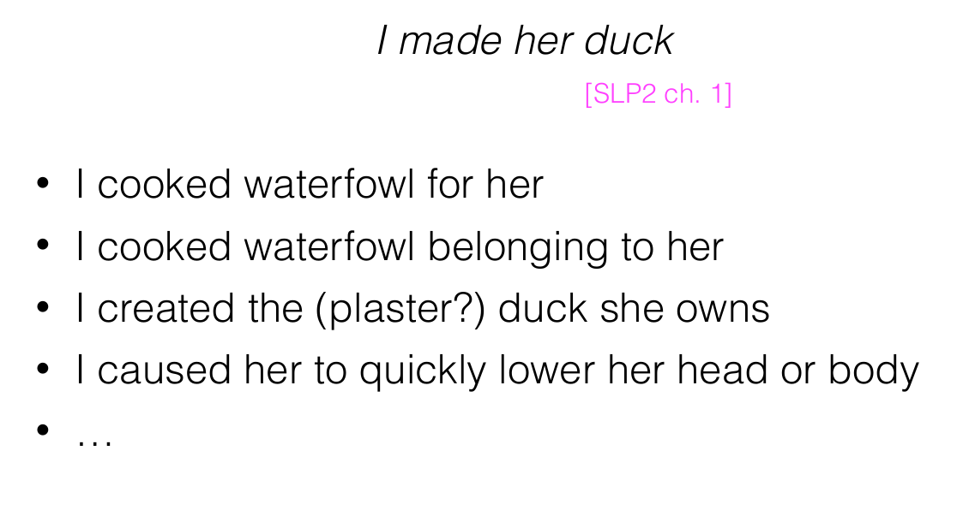

Slide 20
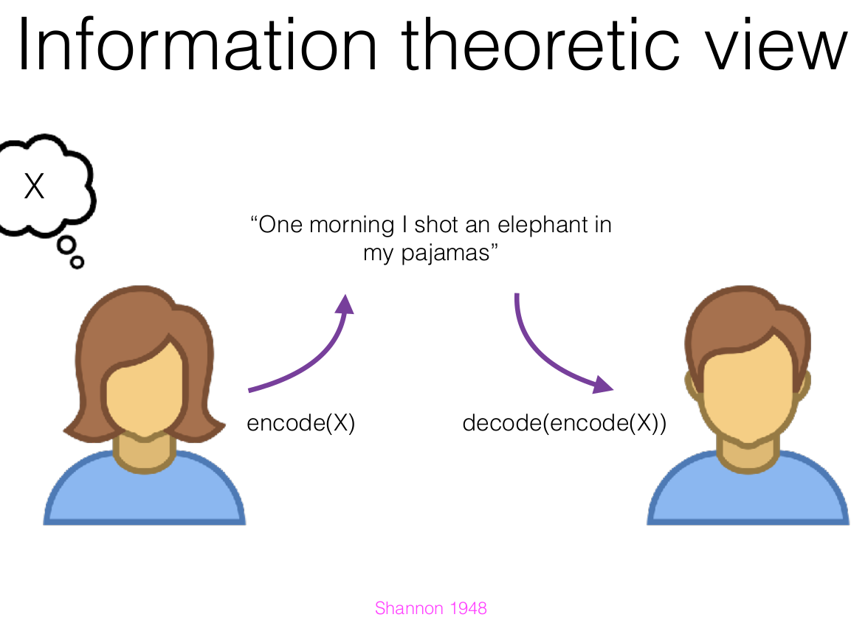

Slide 21
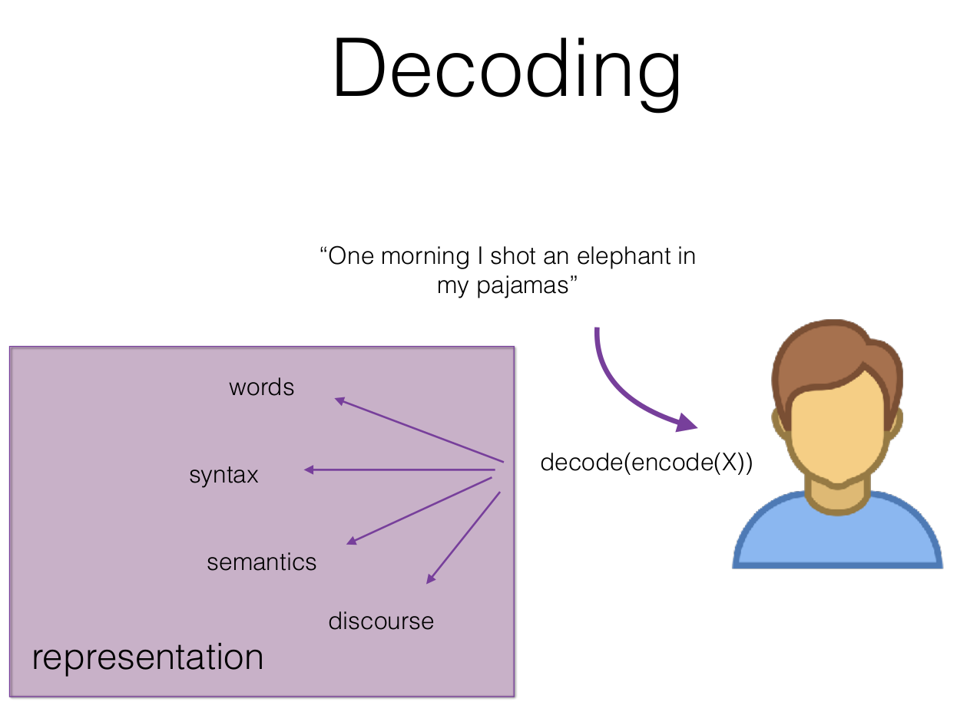

Slide 22
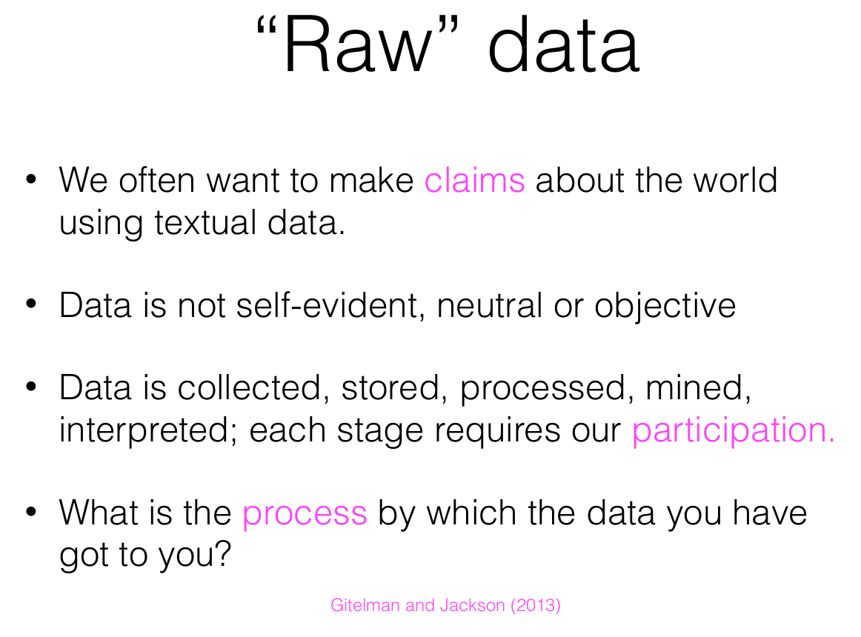

Slide 23

From content to context
200 reviews/minute
“To put things into perspective, 1 Exabyte (10^18) of data is created on the internet daily, amounting to roughly the equivalent of data in 250 million DVDs. Humankind produces in two days the same amount of data it took from the dawn of civilization until 2003 to generate, and as the Internet of Things become[s] a reality and more physical objects become connected to the internet, we will enter the Brontobyte (10^27) Era.
So it’s all dandy that we’re getting better and better at sucking up every trace of potential information out there, but what do we do with these mountains of data? Move over Age of Content, enter the Age of Context.” (https://www.wired.com/insights/2014/02/growing-importance-natural-language-processing/)

Slide 24
The importance of context
When looking at unstructured data, for instance, we may encounter the number ‘31’ and have no idea what that number means, whether it is the number of days in the month, the amount of dollars a stock increased over the past week, or the number of items sold today.
Naked number ‘31’ could mean anything, without the layers of context that explain who stated the data, what type of data is it, when and where it was stated, what else was going on in the world when this data was stated, and so forth. Clearly, data and knowledge are not the same thing.” (https://www.wired.com/insights/2014/02/growing-importance-natural-language-processing/)

Slide 25
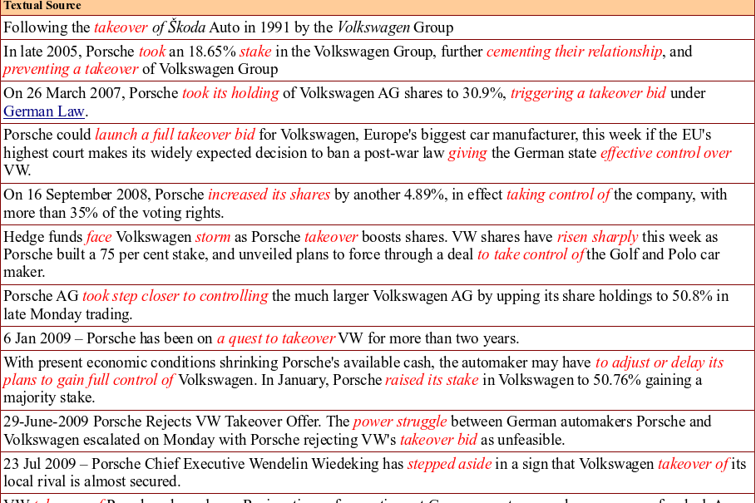
http://www.newsreader-project.eu/

Slide 26
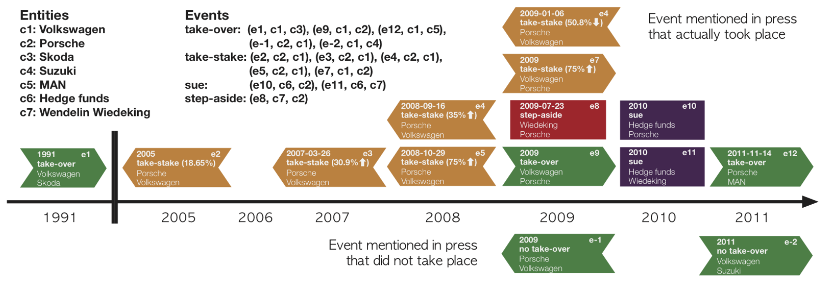
Tasks Overview
http://www.newsreader-project.eu/

Slide 27
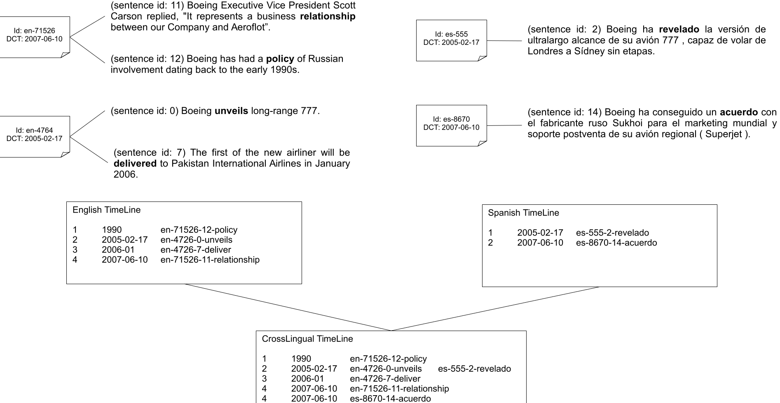
Laparra et al. (2017)

Slide 28
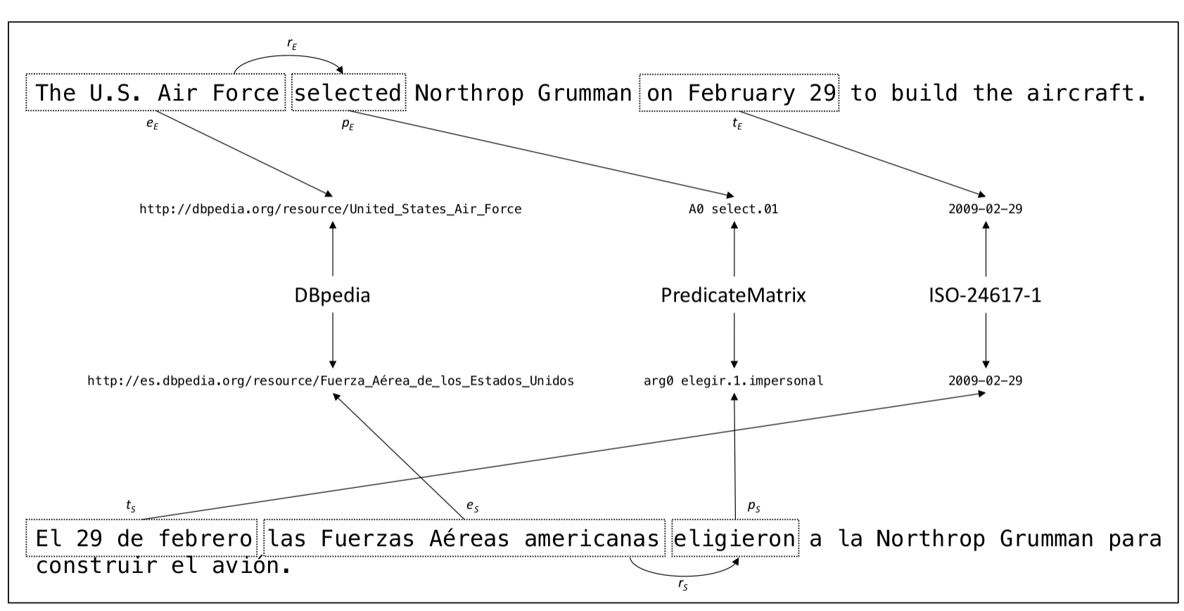
Laparra et al. (2017)

Slide 29
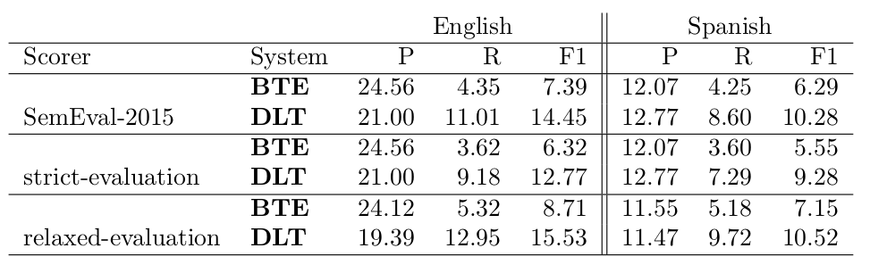
Crosslingual timelines (SOTA)
Laparra et al. (2017)

Slide 30
Text Classification and Sequence Labelling
Sequence Labelling: Named Entity Recognition (NER), POS tagging, Lemmatization, Aspect Based Sentiment Analysis (ABSA), Semantic Role Labelling (SRL), Temporal Detection and Normalization, Question Answering, etc.
Document Classification: Sentiment Analysis, Fake News, Stance, Hyper Partisanism, Topic Detection, Spam Detection, etc.

Slide 31
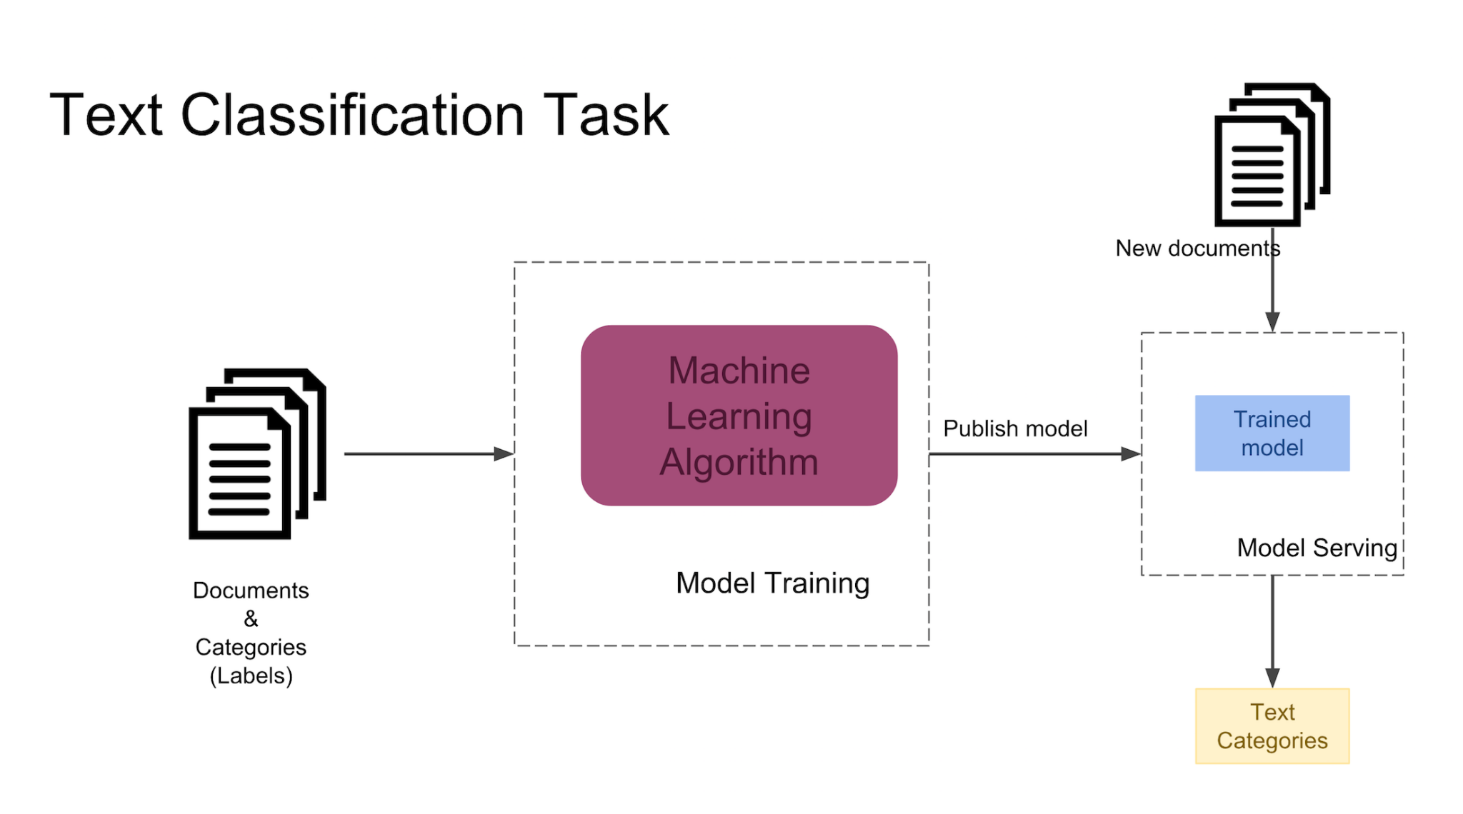
Standard classification problem assumes individual cases are disconnected and independent (i. i. d. : independently and identically distributed). Many NLP problems do not satisfy this assumption and involve making many connected decisions, each resolving a different ambiguity, but which are mutually dependent.

Slide 32
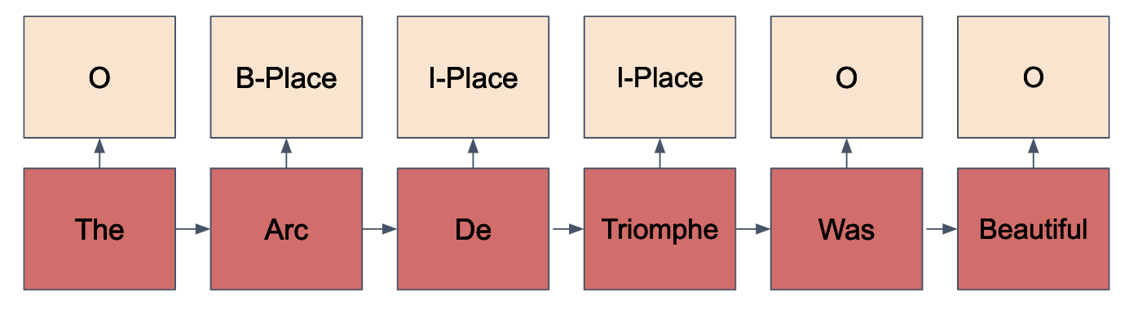
Sequence Labelling
Each token in a sequence is assigned a label.
Labels of tokens are dependent on the labels of other tokens in the sequence, particularly their neighbors (not i. i. d).

Slide 33
Named Entity Resolution
The disappearance of York University chef Claudia Lawrence is now being treated as suspected murder, North Yorkshire Police said. However detectives said they had not found any proof that the 35-year-old, who went missing on 18 March, was dead. Her father Peter Lawrence made a direct appeal to his daughter to contact him five weeks after she disappeared. His plea came at a news conference held shortly after a 10,000 reward was offered to help find Miss Lawrence. Crimestoppers said the sum they were offering was significantly higher than usual because of public interest in the case.

Slide 34
Named Entity Resolution (NER)
[[The disappearance of [York University chef Claudia Lawrence]] is now being treated as suspected murder, North Yorkshire Police said. However detectives said they had not found any proof that the 35-year-old, who went missing on 18 March, was dead. [Her father Peter Lawrence] made a direct appeal to his daughter to contact him five weeks after she disappeared. His plea came at a news conference held shortly after a 10,000 reward was offered to help find Miss Lawrence. Crimestoppers said [the sum] they were offering was significantly higher than usual because of public interest in the case.

Slide 35
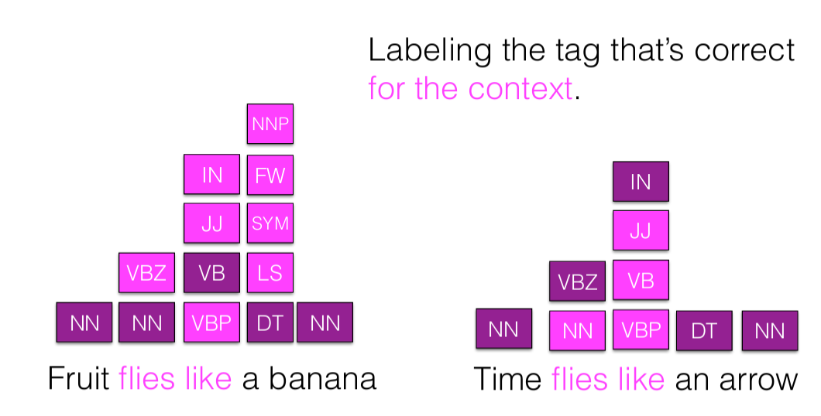
POS Tagging

Slide 36
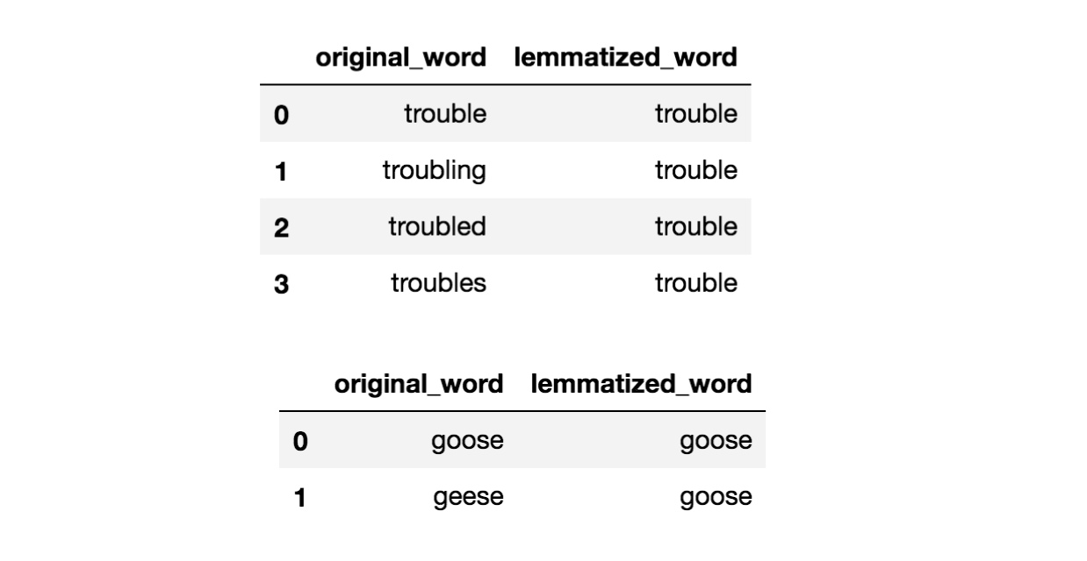
Lemmatization

Slide 37
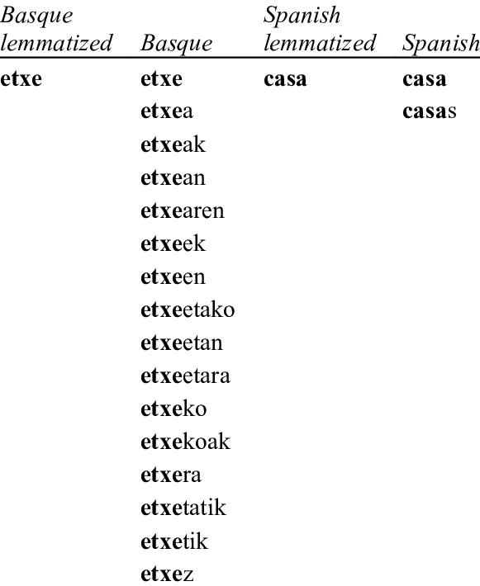
Lemmatization

Slide 38
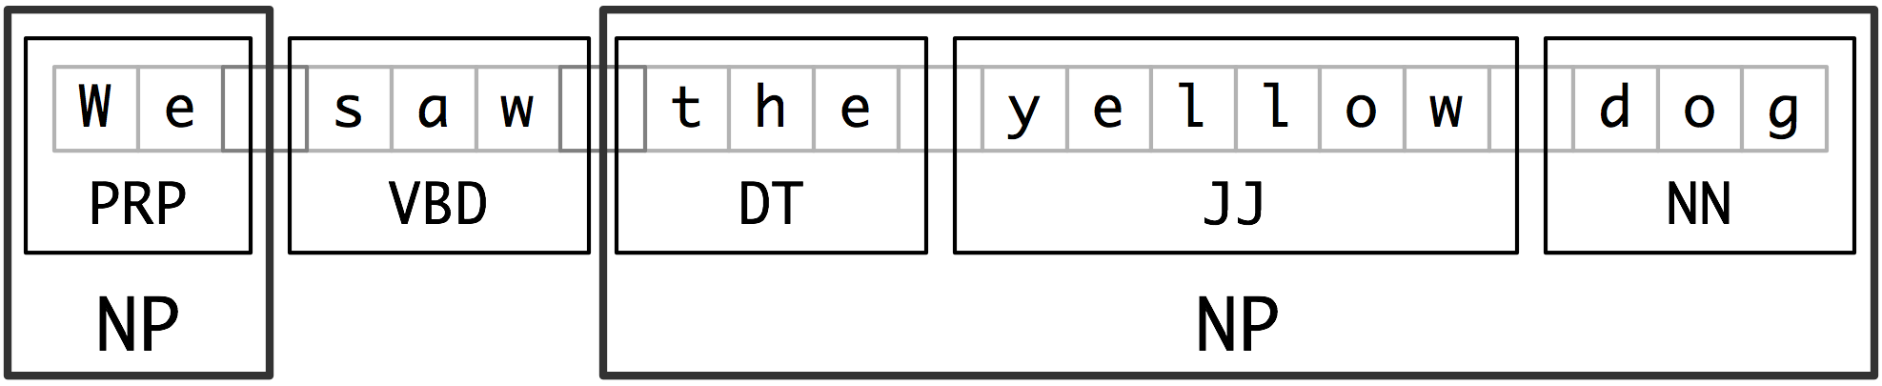
Chunking

Slide 39
Semantic Role Labelling
“He would not accept anything of value from those he was writing about.”
[A0 He ] [AM-MOD would ] [AM-NEG not ] [V accept ][A1 anything of value ] from [A2 those he was writing about ] .
V: verb
A0: acceptor
A1: thing accepted
A2: accepted-from
A3: attribute
AM-MOD: modal
AM-NEG: negation

Slide 40
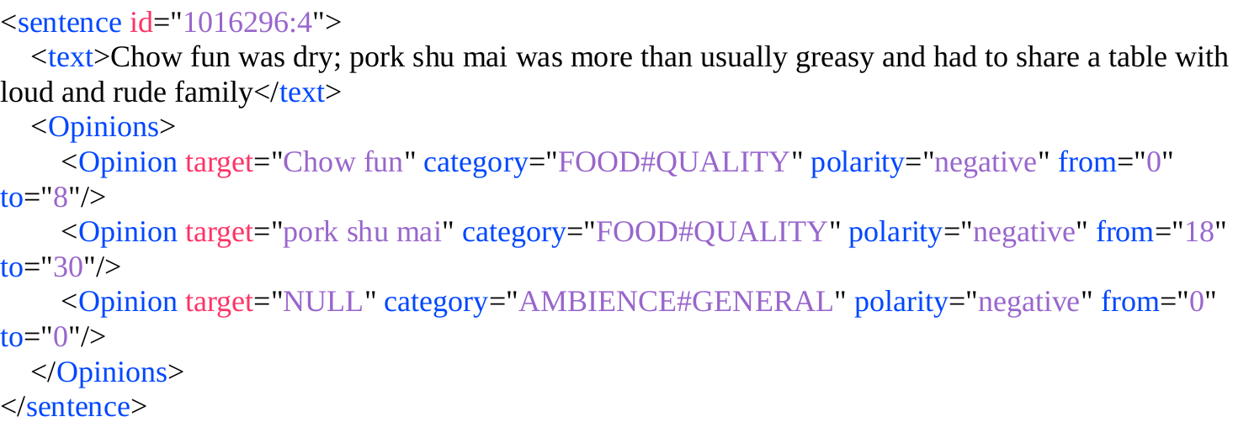
Aspect Based Sentiment Analysis

Slide 41
Sentiment Analysis

Slide 42
Text Classification
This place is not good enough, especially the service is disgusting.
Positive or negative?
Subjective or Objective?
Restaurant or Electronics?
Favour or Against (going there)

Slide 43
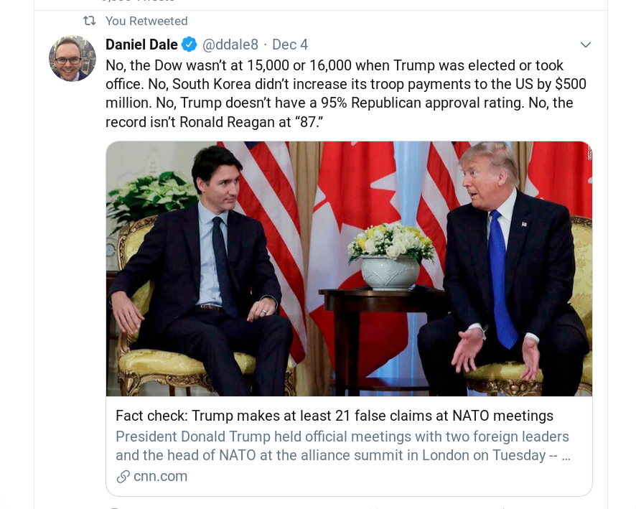
Fake News
Target:
Hillary Clinton
Tweet:
Donald Trump is the only sane candidate for 2016.
Task:
Favor, Against, None

Slide 44
NLP - Common tasks
Performance
POS tagging (morphology)
Named Entity Recognition and Disambiguation
Entity Relation Extraction
Opinion Mining, Fake news
Semantic Role Labelling
Timelines
Non-standard language - Normalization

Slide 45
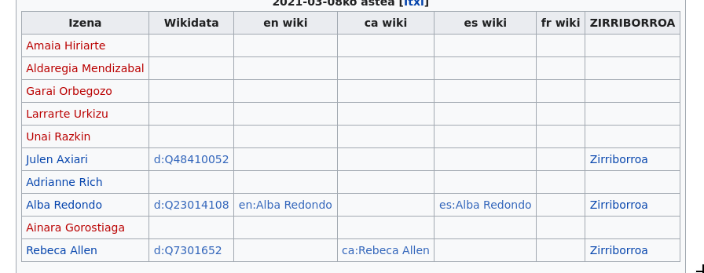
Article generation in Basque Wikipedia
https://eu.wikipedia.org/wiki/Wikiproiektu:Euskarazko_albisteetako_Izen_Entitateak

Slide 46

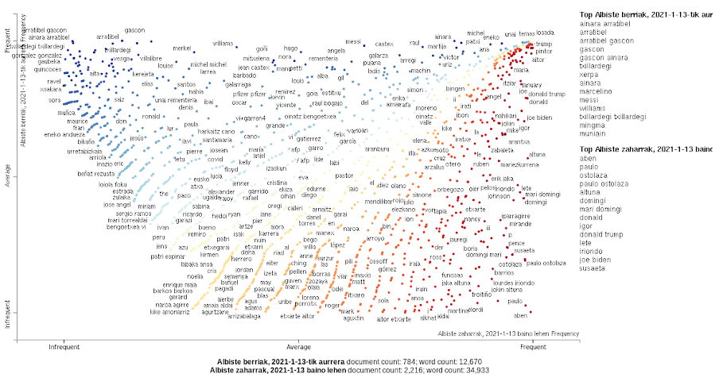
Article Generation in Basque Wikipedia
Visualization
• TF-IDF
• Wikipedia entry
• Scattertext
RSS feed
Basque media
IE
• News extraction
• Named Entity Recognition
• Lemmatization
Named Entities DB
News DB
Meaningfull NE DB

Slide 47
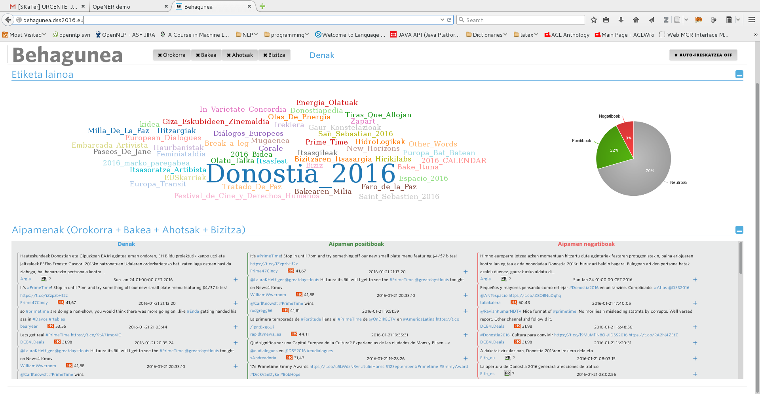
http://behagune.elhuyar.eus/

Slide 48
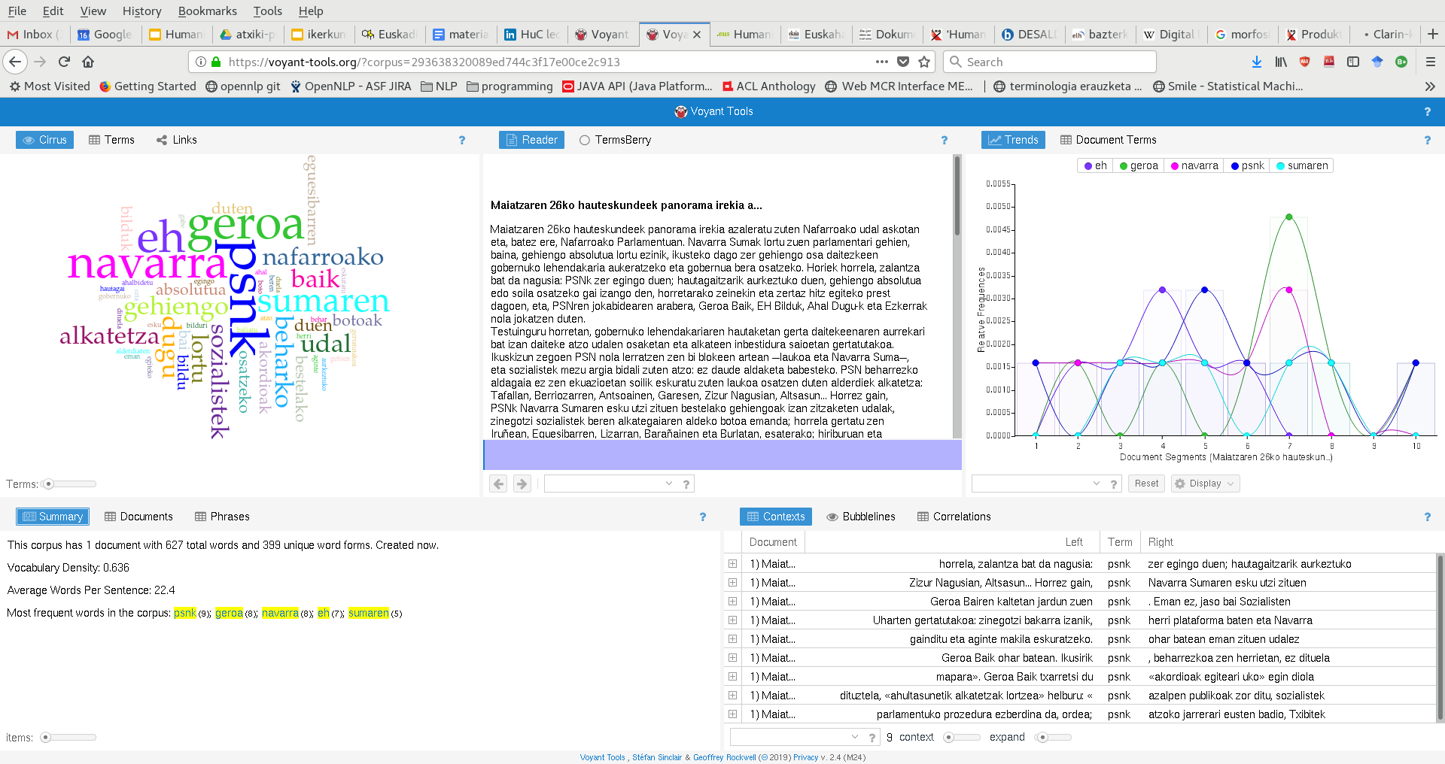
https://voyant-tools.org/

Slide 49
Mila esker!

